Slide 1
Early Career Researchers
Nepal
Satya Shrestha (PhD Scholar)
Pusp Raj Bhatt
Samita KC
Smriti Luitel

Slide 2
Major Activities
Planning and Organization
Participatory observation in intervention sites
Monitoring and supervision visits
Coordination
Data collection (FGDs, KII, MSC stories, PIM)
Transcription and translation of Interviews, FGDs
Data analysis
Report writing
Administrative/Financial roles and responsibilities

Slide 3
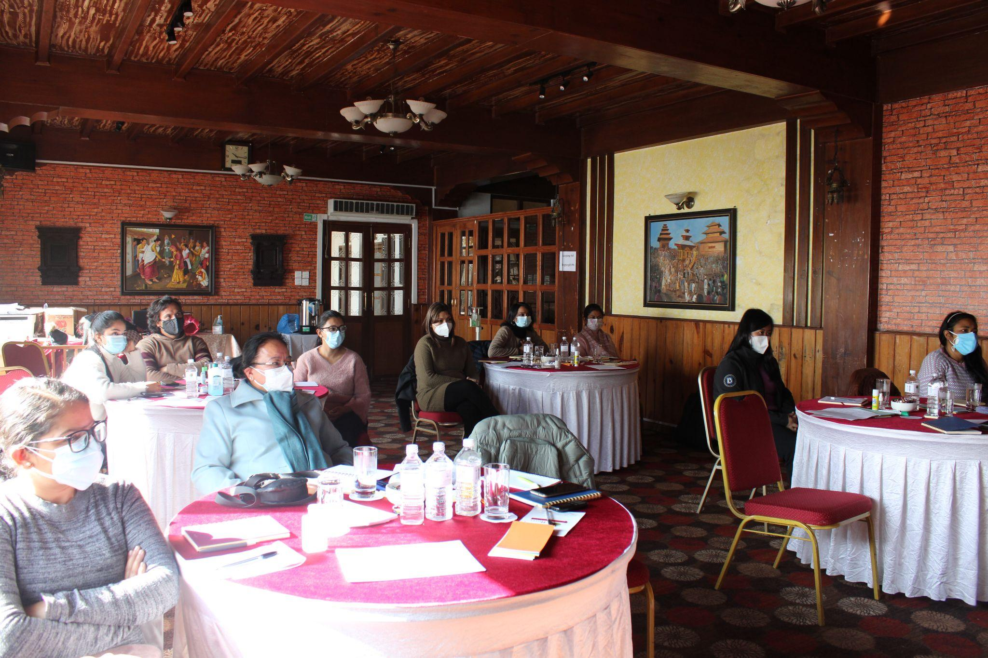
Early Career Researchers Workshop

Slide 4
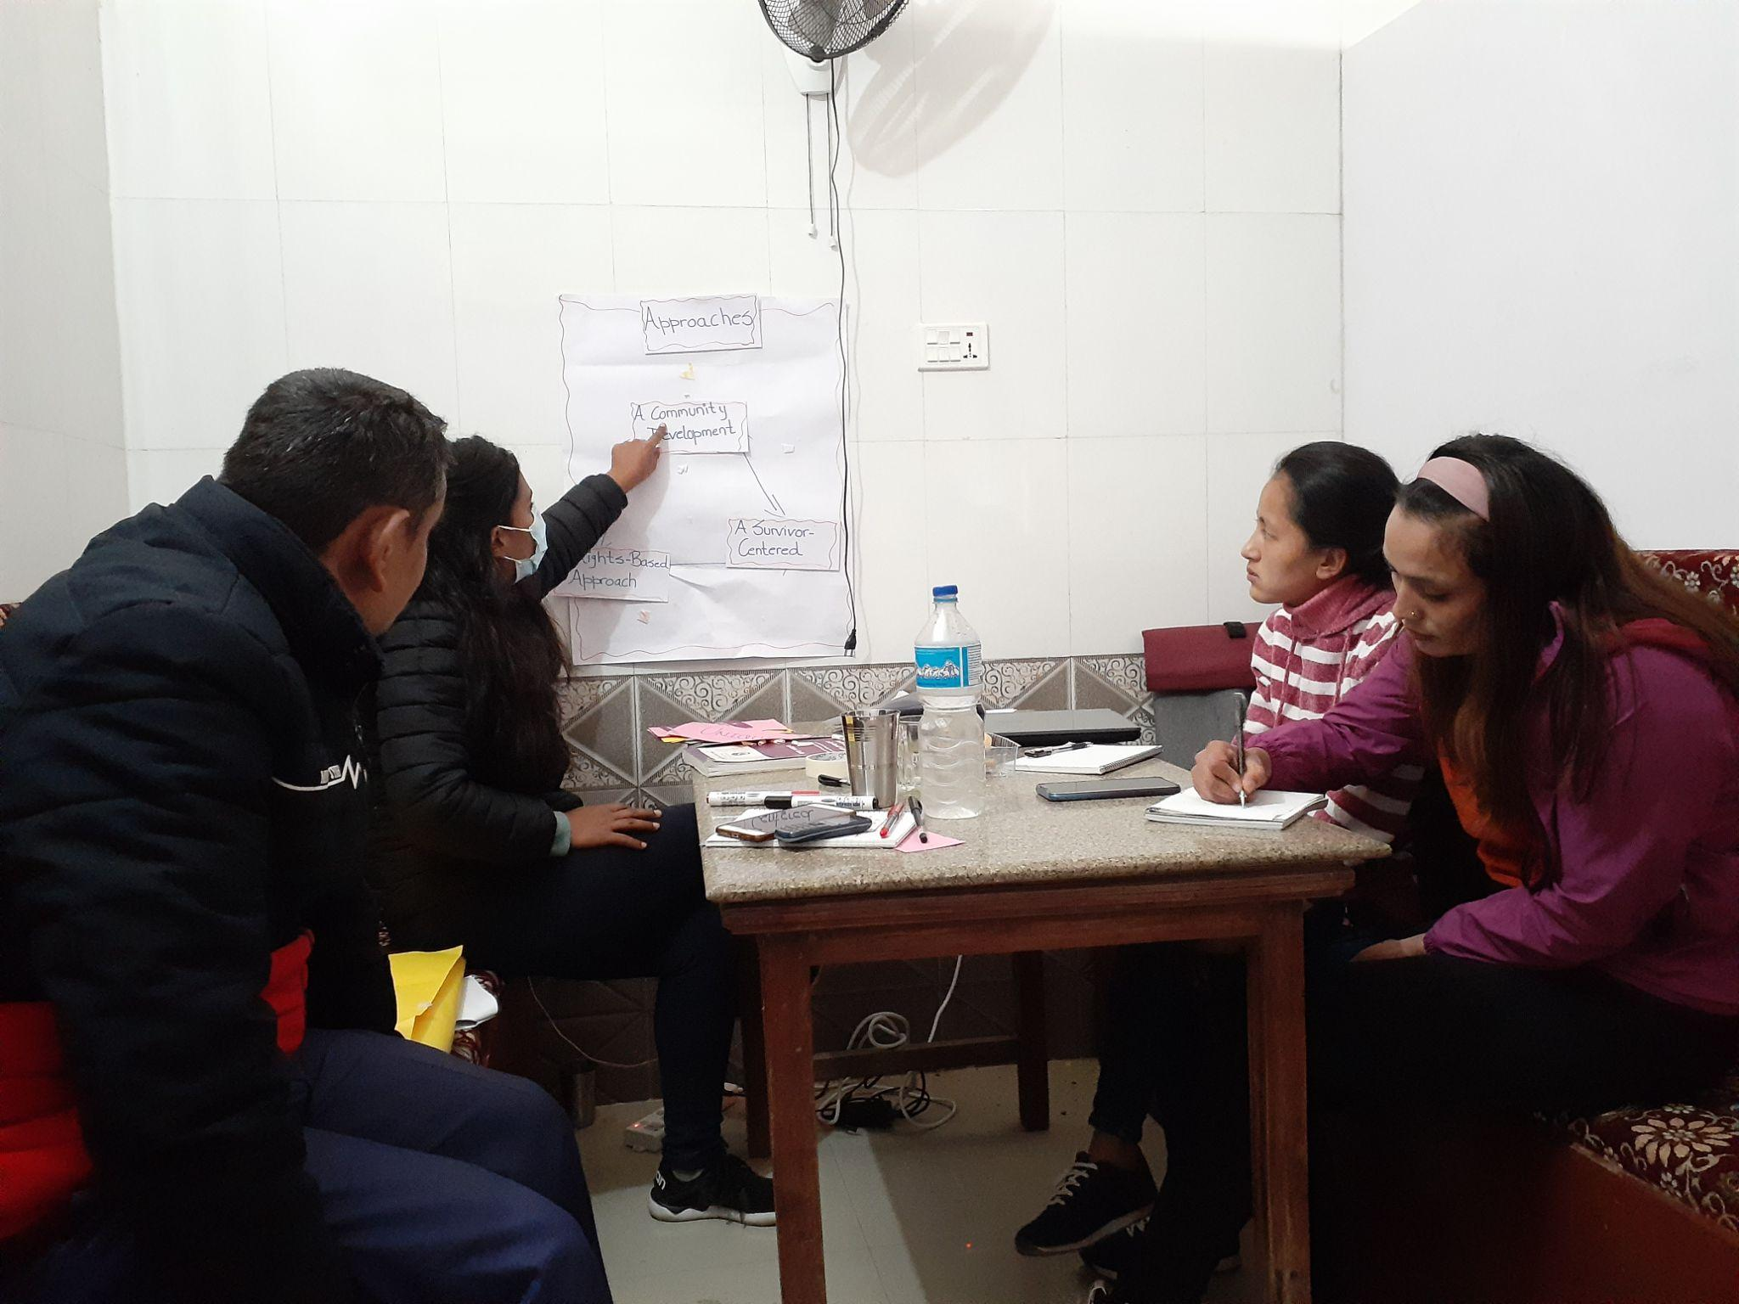
Training to Health Care Providers

Slide 5
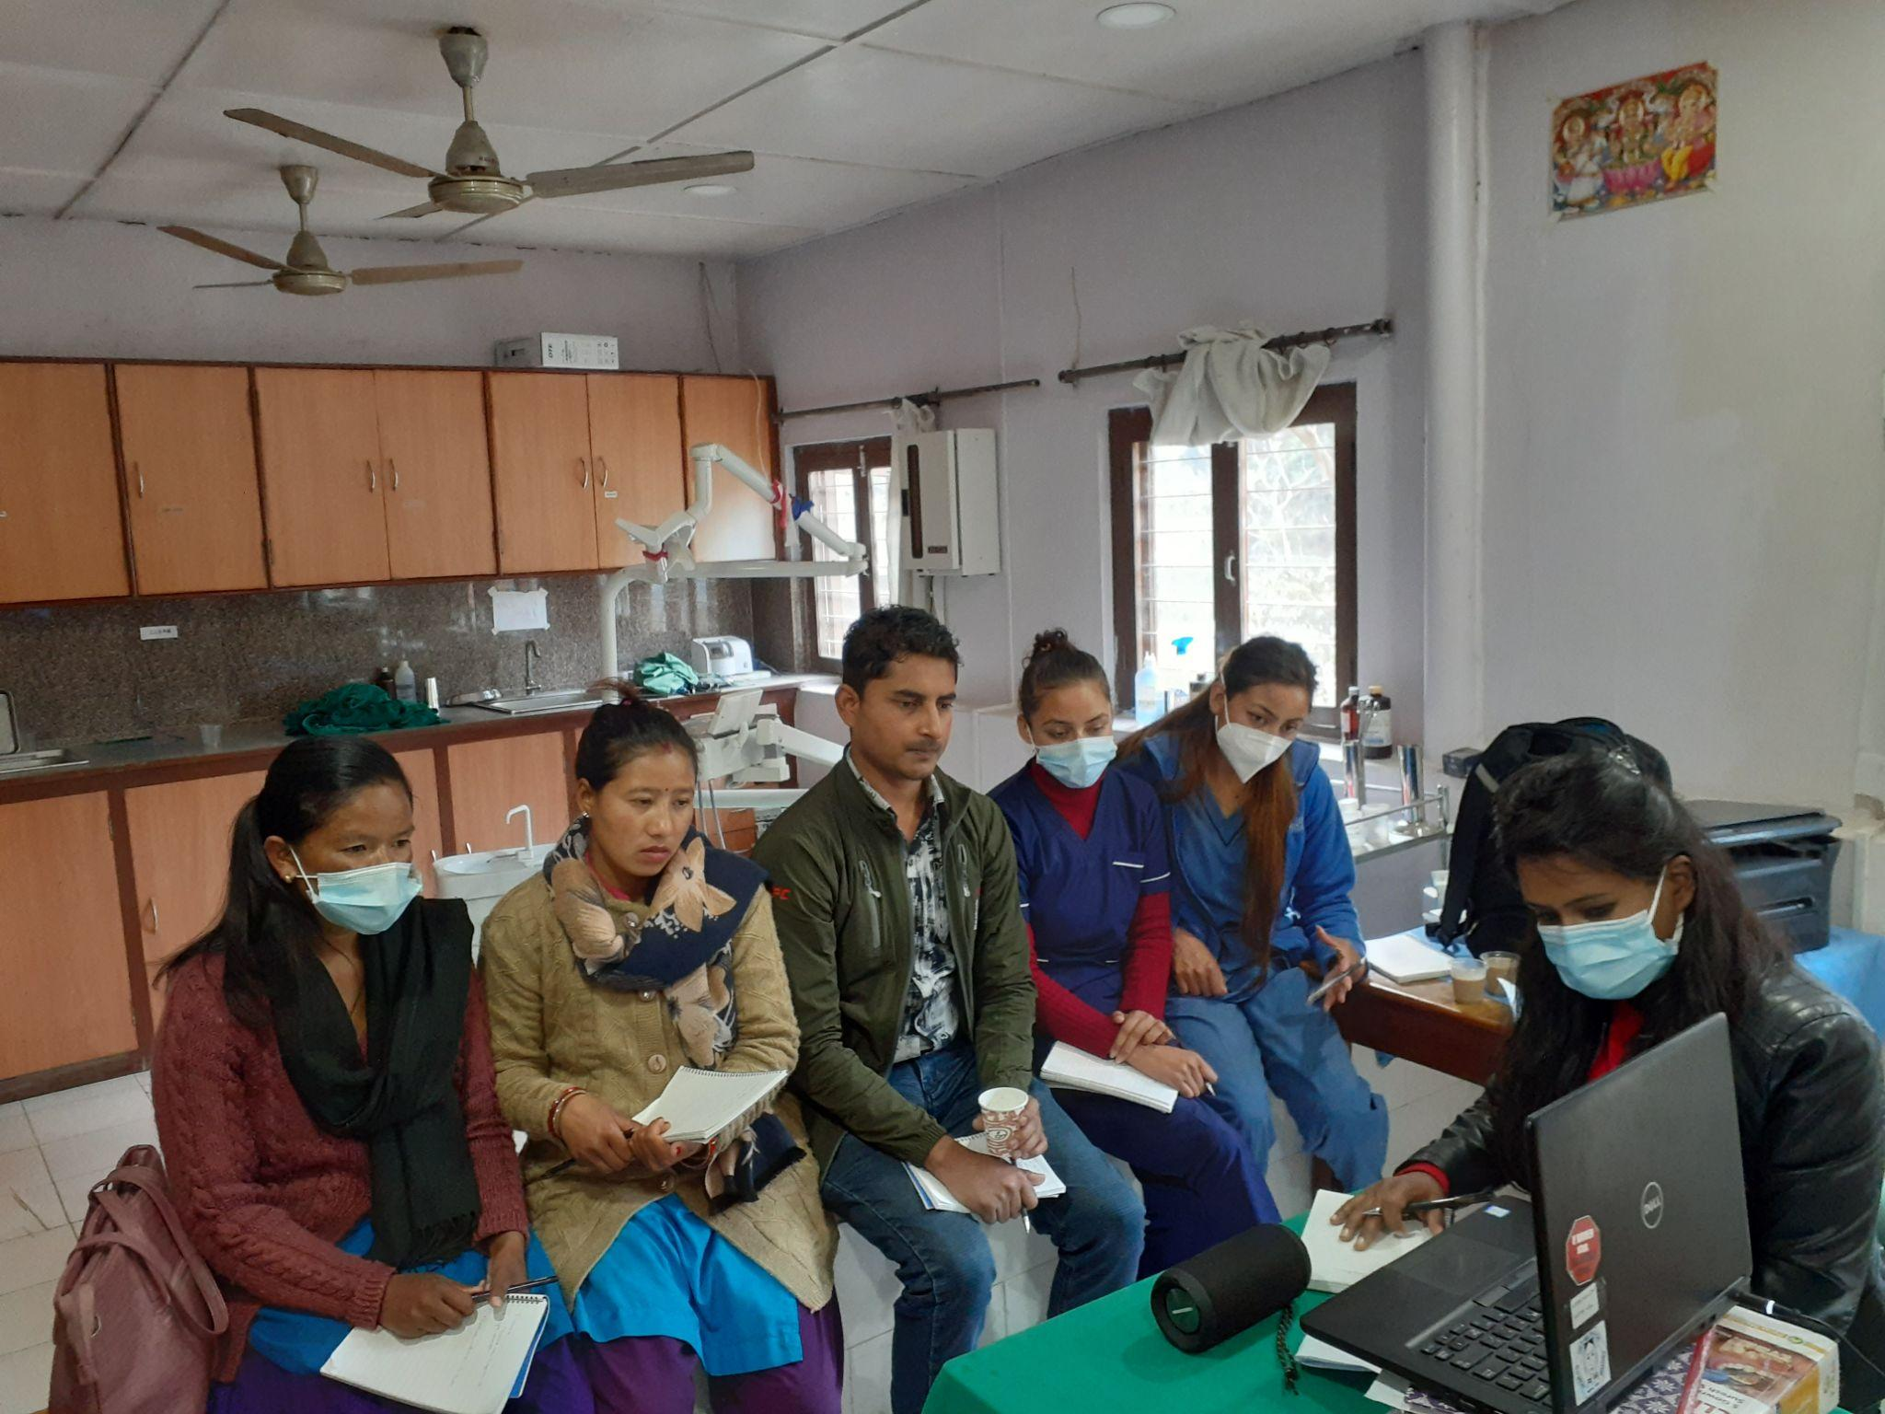
Training to Health Care Providers

Slide 6
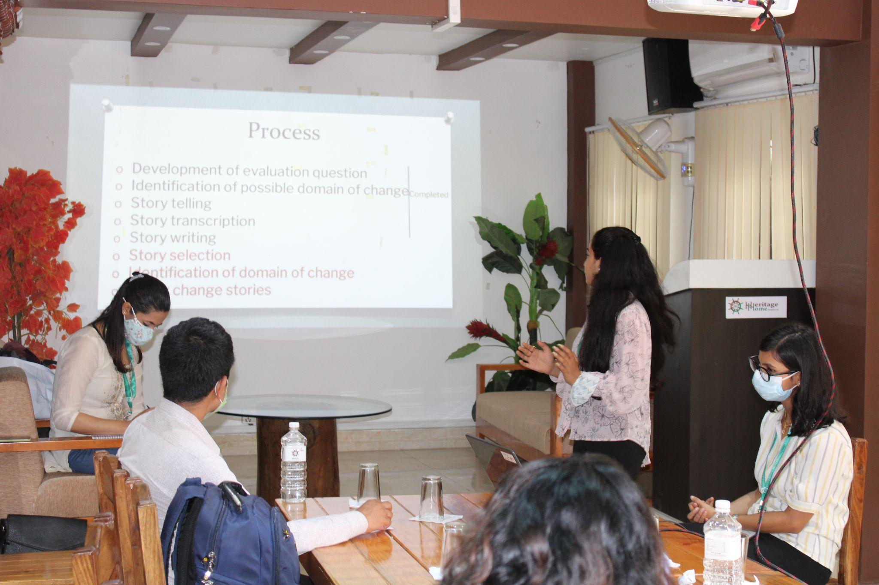
Most Significant Change Stories selection with stakeholders

Slide 7
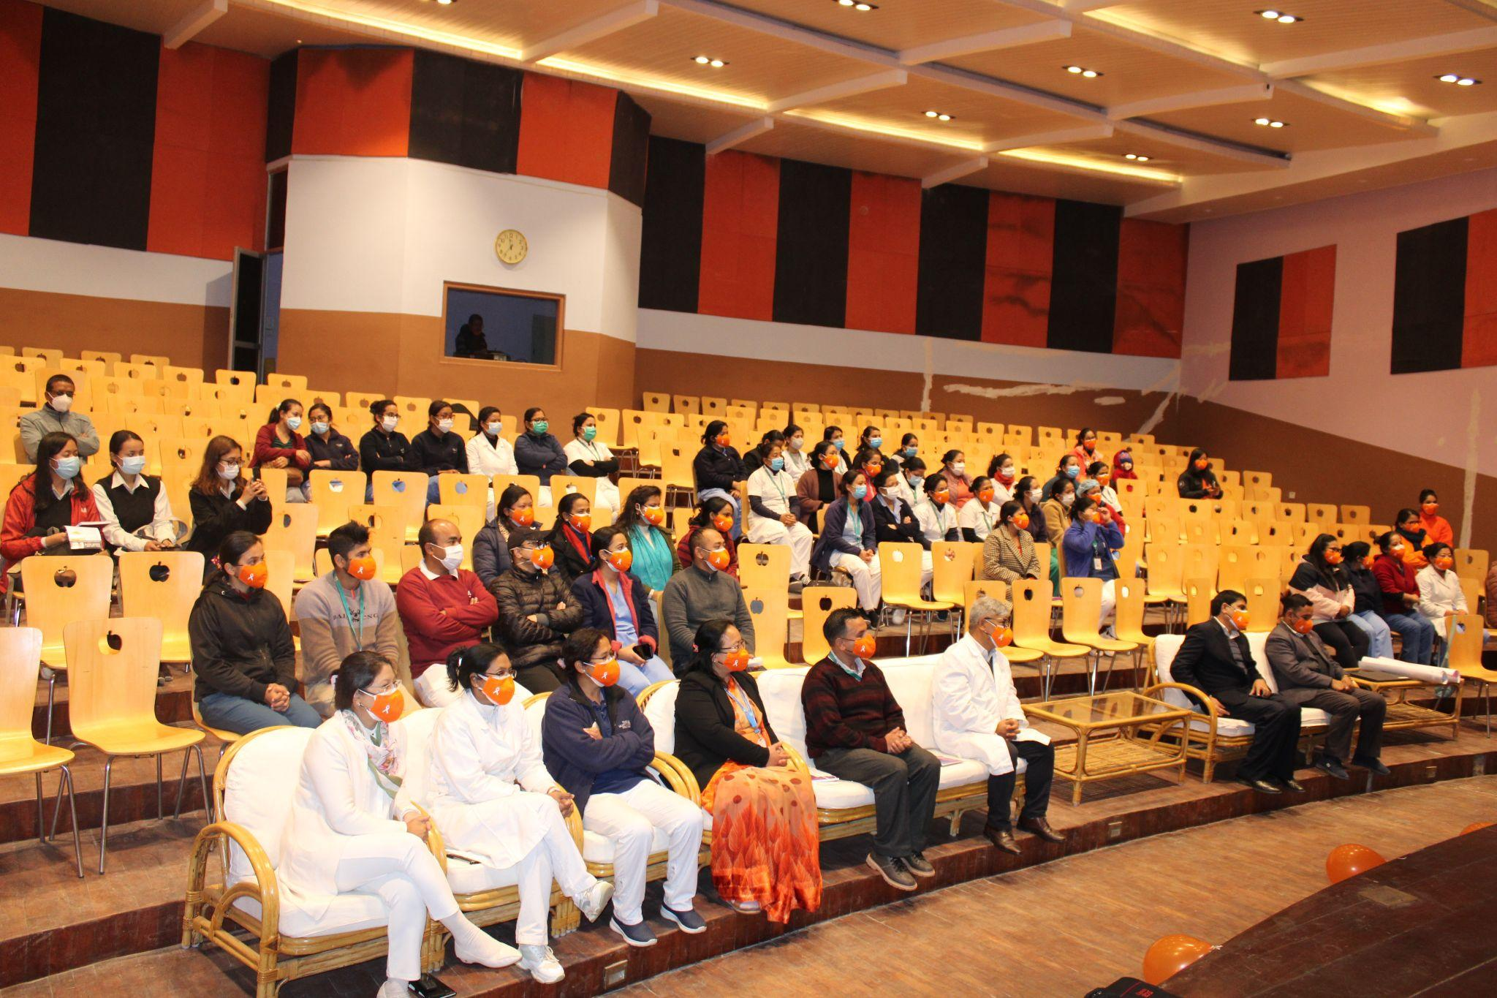
Story Exhibition for 16 days of activism against GBV

Slide 8
Major Learnings
Gender Sensitivity
Coordination
Workplace collaboration
Enhanced team building
Networking and socializing
Interpersonal development
Ad-hoc planning
Research Ethics

Slide 9
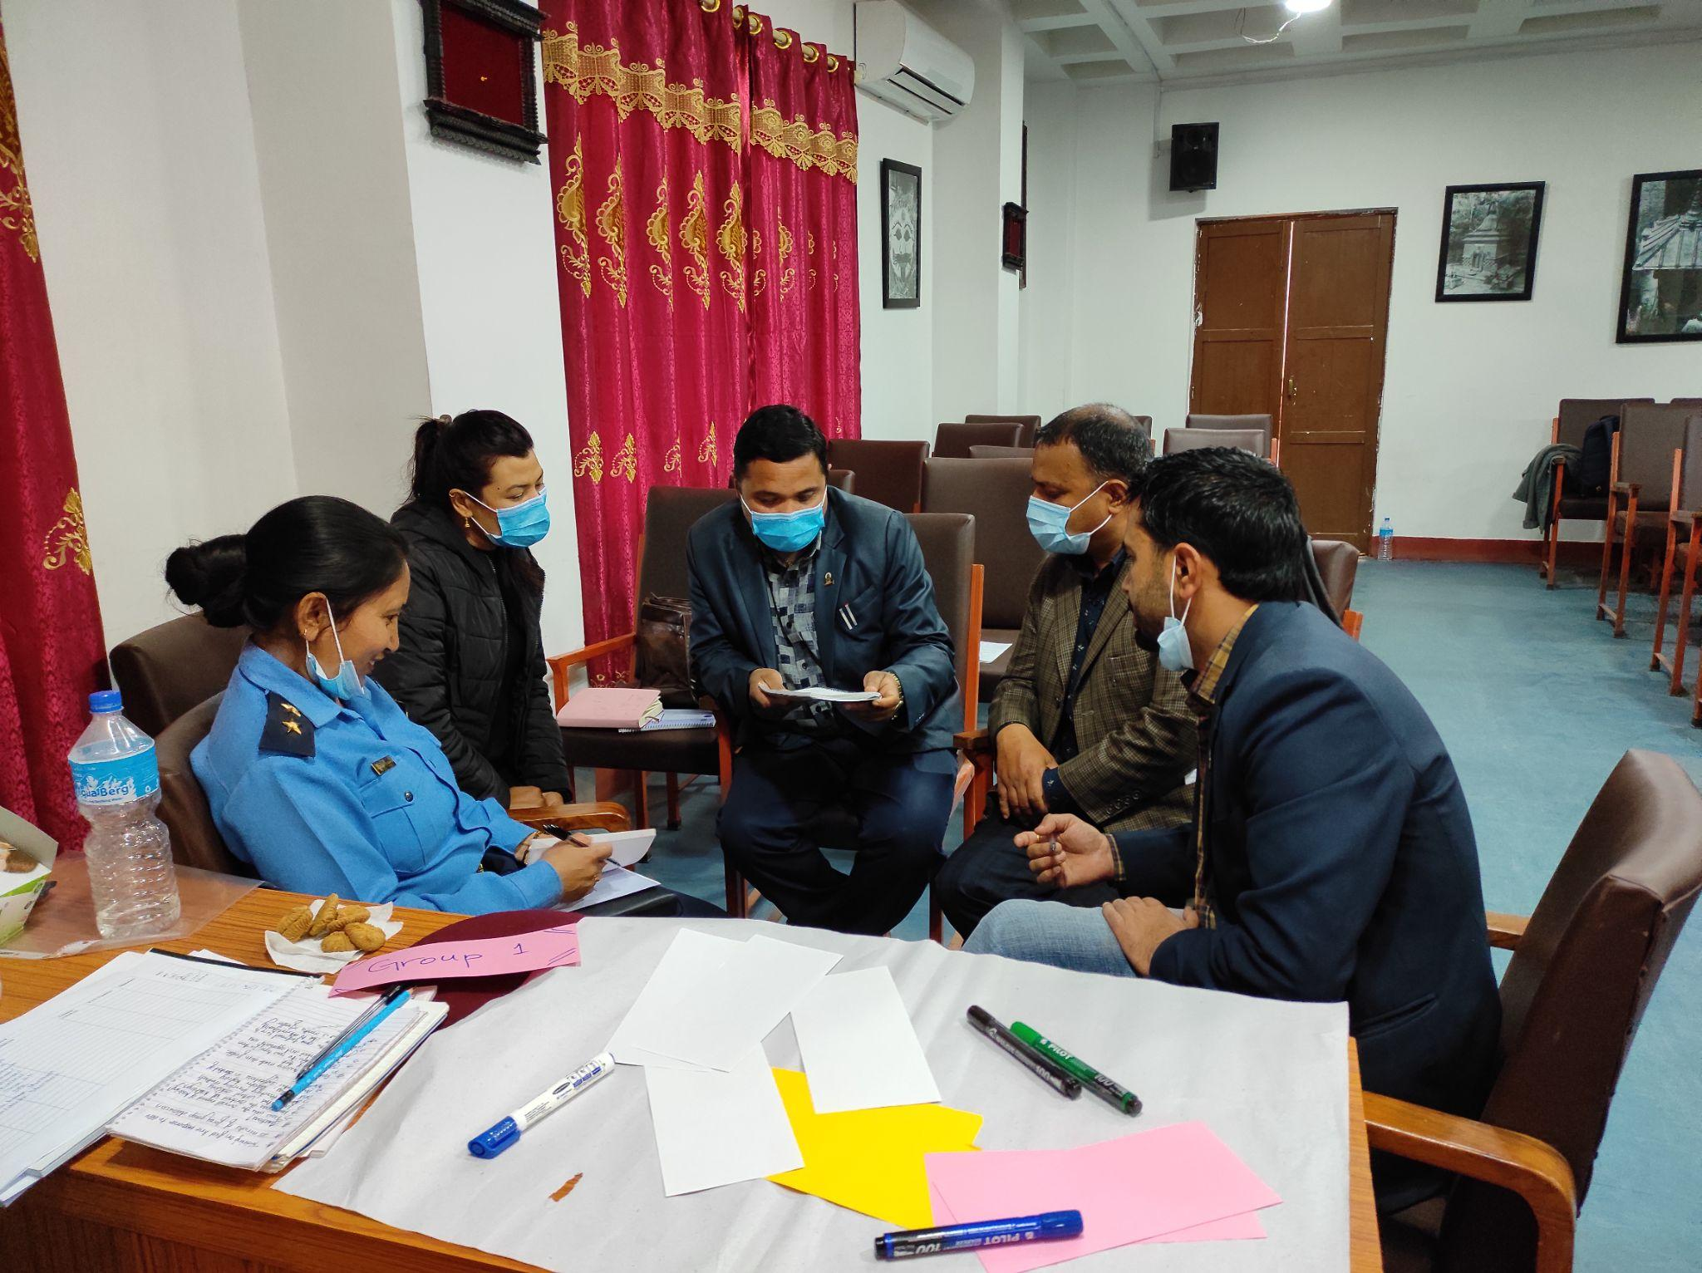
Country Level Stakeholders Meeting

Slide 10
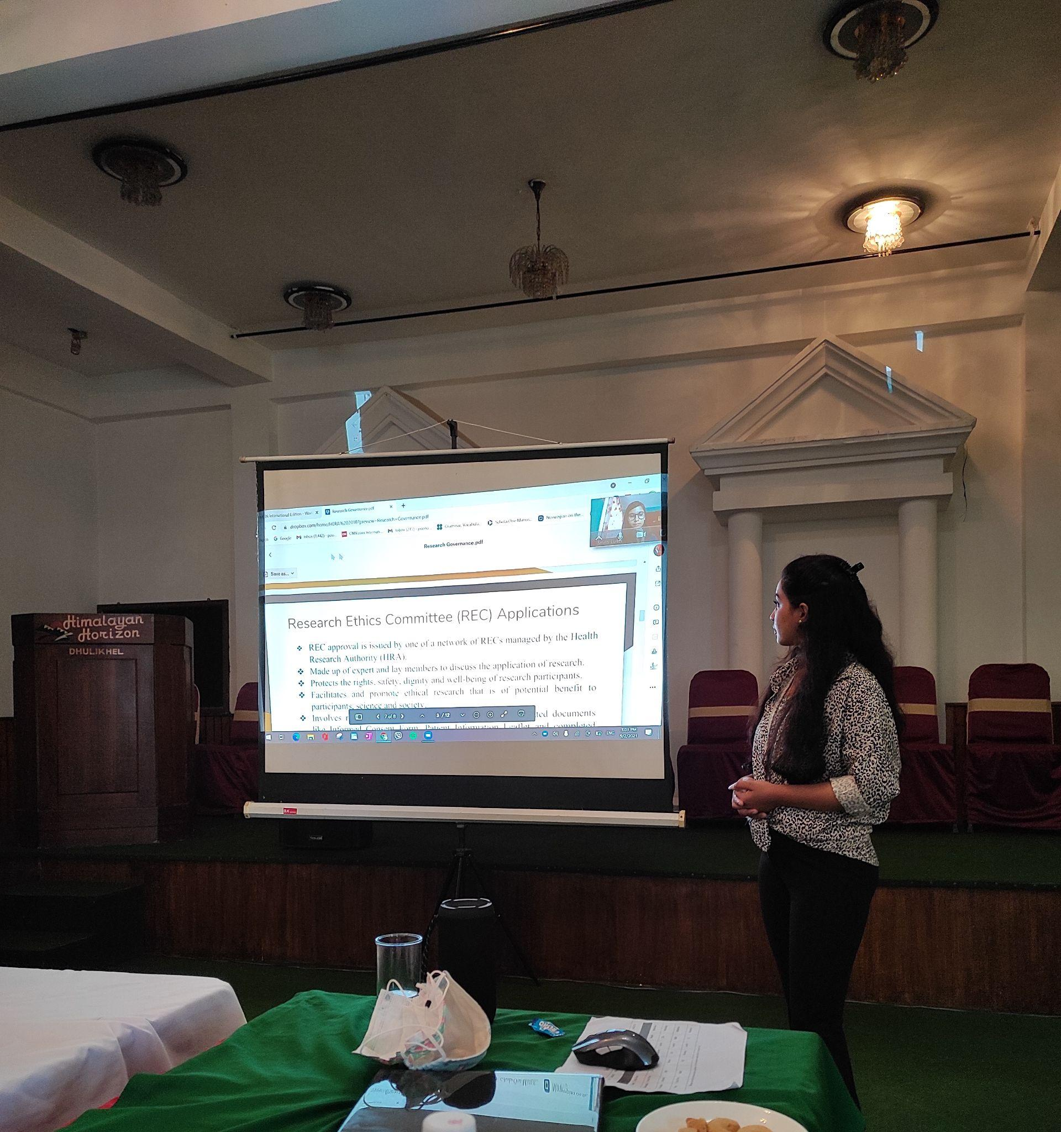
Sharing learnings of UoB Short Course

Slide 11
Appreciations
Opportunity to explore viewpoints of other early career researchers.
Forum for communication
Virtual team building events
Capacity strengthening programs
Unlocking self potentials
Team inclusion
Proper mentorship
Success celebration
Travelling
Notes:
Enhancing team performance: Due to non-hierarchical team leadership

Slide 12
Publications of Research Paper

Slide 13
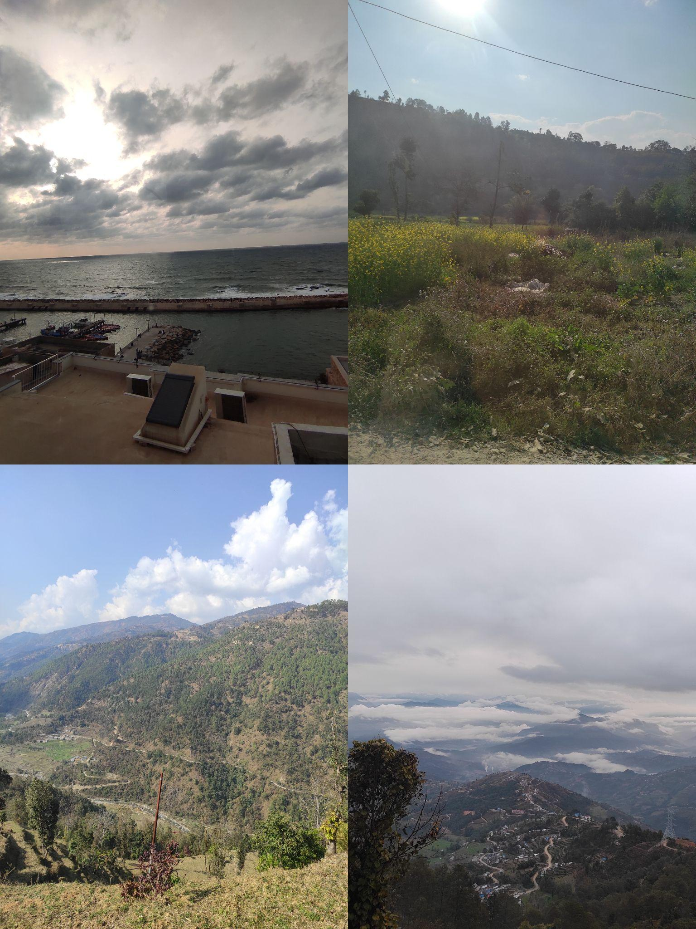
Glimpses from field visits

Slide 14
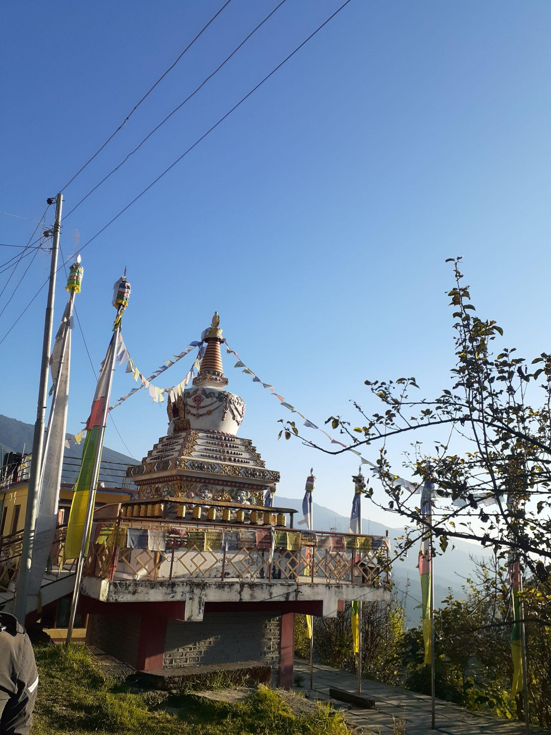
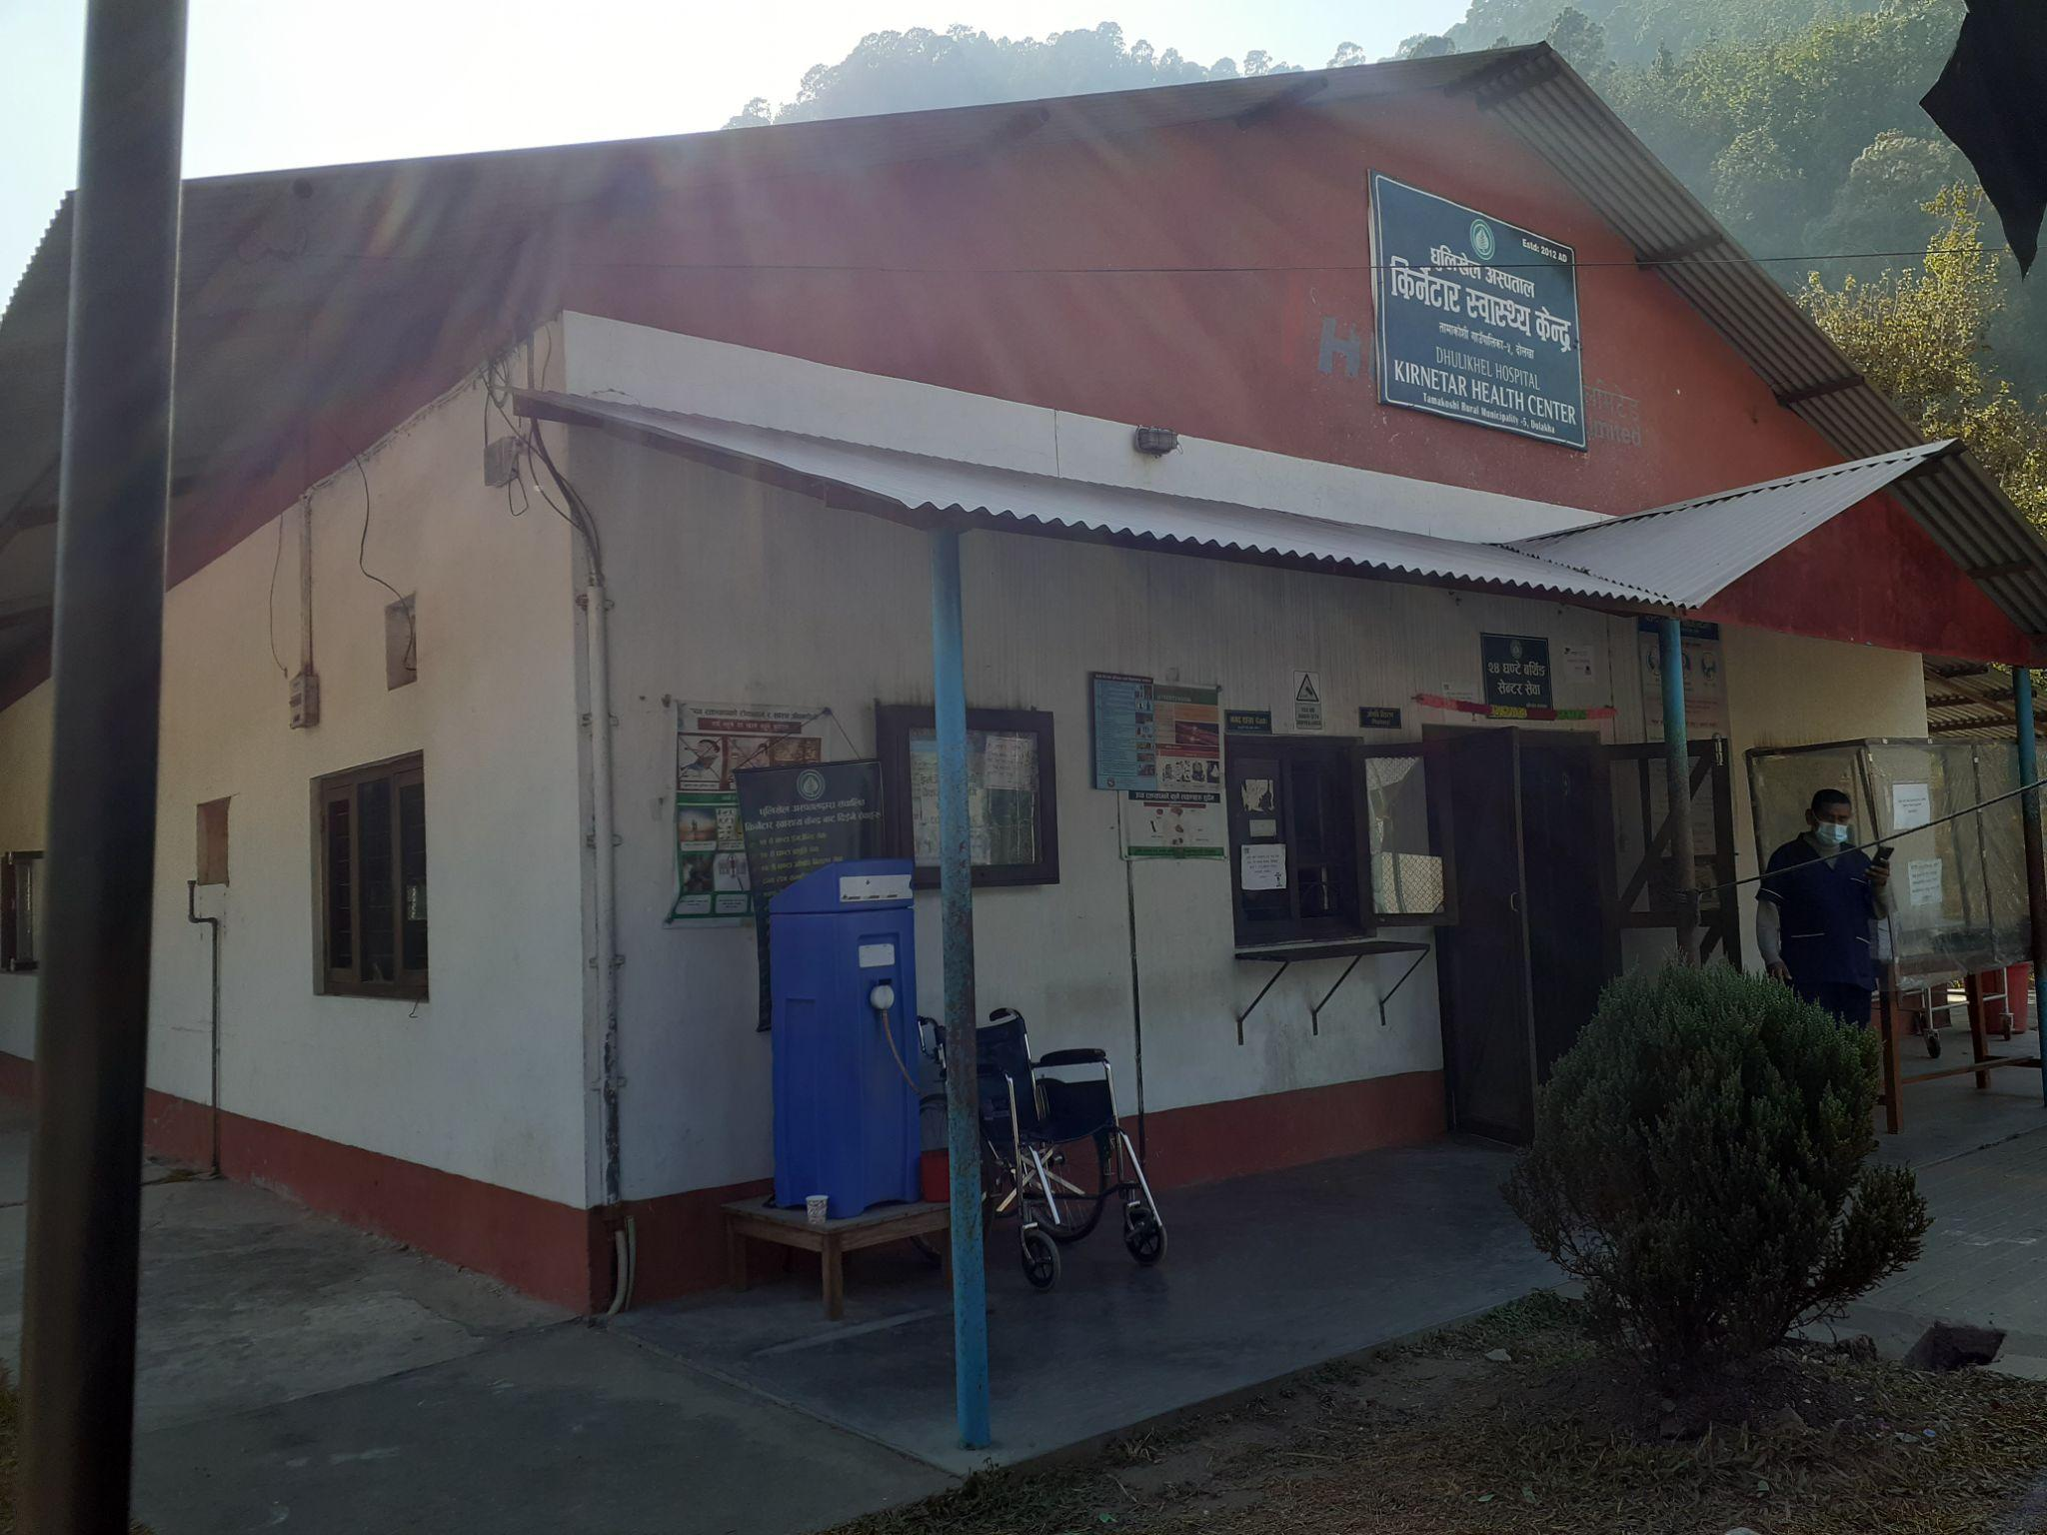
Glimpses from field visits

Slide 15
Challenges
Avoidable
Staff turnover and workload
Lack of knowledge and practice among stakeholder
Less priority to GBV
No standard guideline
Hierarchy
Lack of coordination and collaboration
Poor in documentation
Lack of infrastructure eg. no dedicated room
Safety and security issues
Unavoidable
COVID-19 pandemic
Geographical difficulties during field visit
Natural calamities eg,Flood,landslides etc
Strike due to political instabilities.

Slide 16
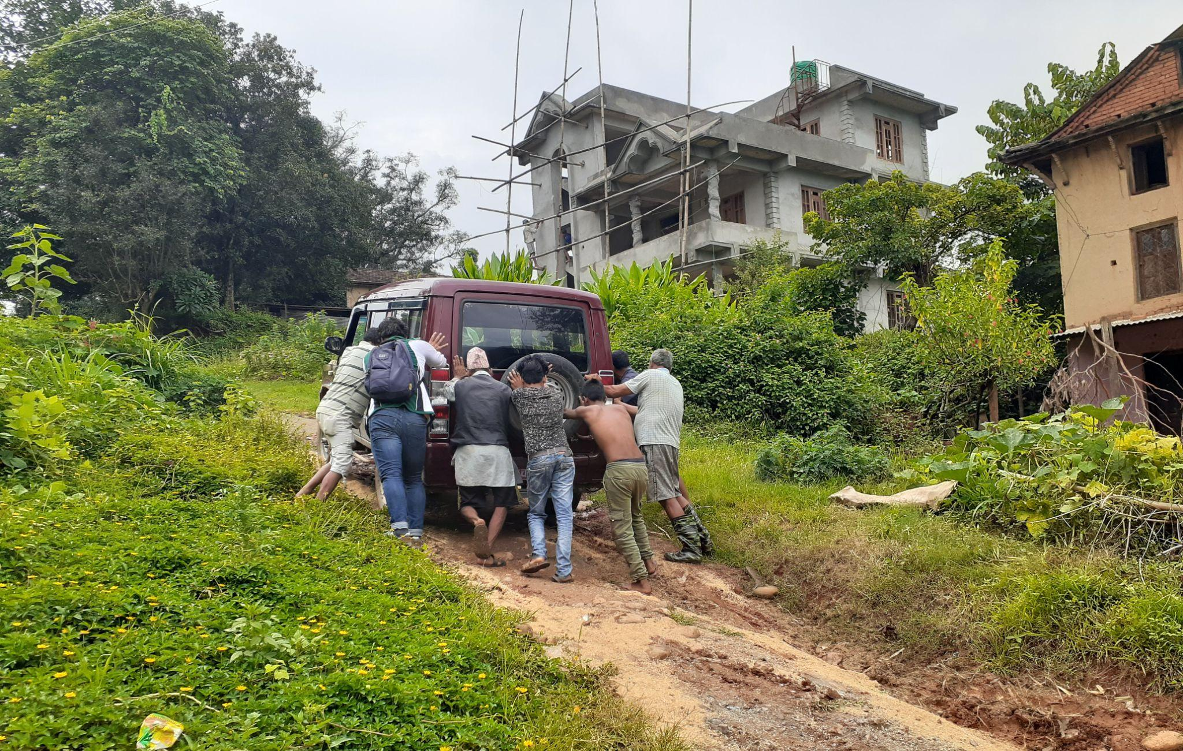

Slide 17
Forward looking
Creating further collaborative work
Opportunities for further capacity strengthening
Building strong relationship among ECRs
Workshop and training opportunities

